Slide 1
RPO Search Script

Slide 2
Contents
Windows set up
MacOS set up
About the Files
Using the Scripts

Slide 3
Make sure to read
Please go through this entire slide deck to understand the process, regardless if you are on Windows or MacOS

Slide 4
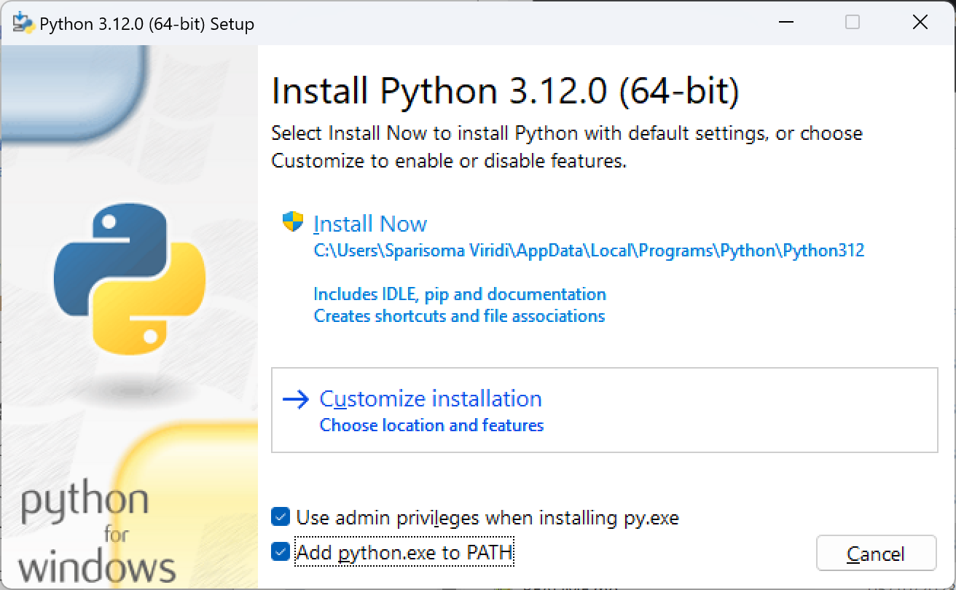
Windows Set up
Make sure you have the following installed:
Python 3.12 (https://www.python.org/downloads/) make sure you install pip and add Python to PATH/environment variables when installing
Google Chrome Browser
Files from GitHub (make sure to extract all)
Chrome Web Driver (Win64) This is included in the Git File, only replace if it does not work

Slide 5
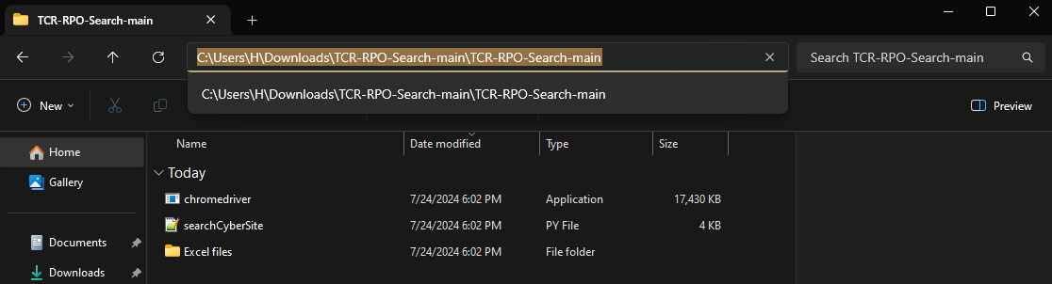
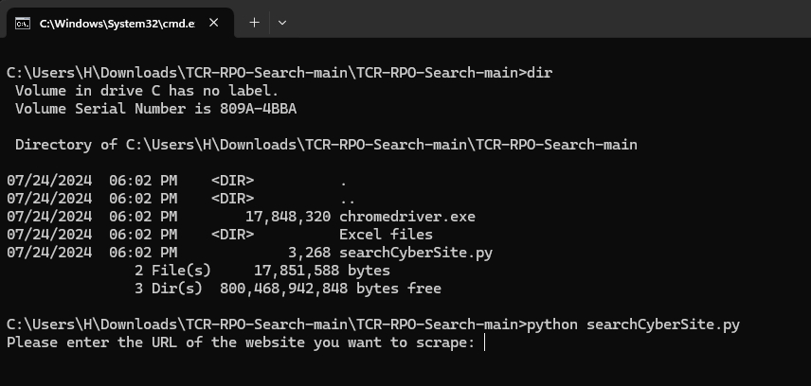
Windows Set up
Open the extracted GitHub folder.
In the navigation bar, type “cmd” and press enter. This will open a command prompt in this folder.
Run command ‘pip install pandas’
Run command ‘pip install selenium’
Run command ‘pip install beautifulsoup4’
Run command ‘pip install openpyxl’
(try pip3 if pip does not work)
Now you should be able to run command ‘python searchCyberSite.py’ or ‘python3 searchCyberSite.py’.

Slide 6
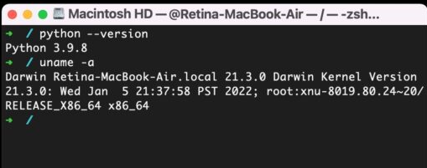
MacOS set up
Make sure you have the following installed:
Python 3 (should be preinstalled, check in terminal with command ‘python --version’ or ‘python3 --version’)
Google Chrome Browser
Files from GitHub (make sure to extract all)
Chrome Web Driver (M1 Chip or Intel Chip) This is included in the Git File, only replace if it does not work

Slide 7
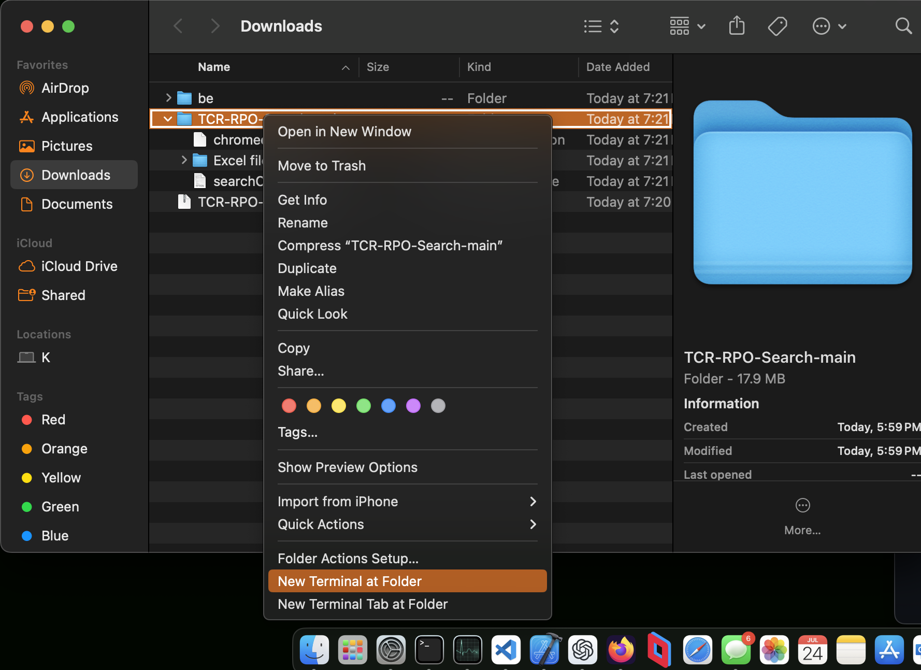
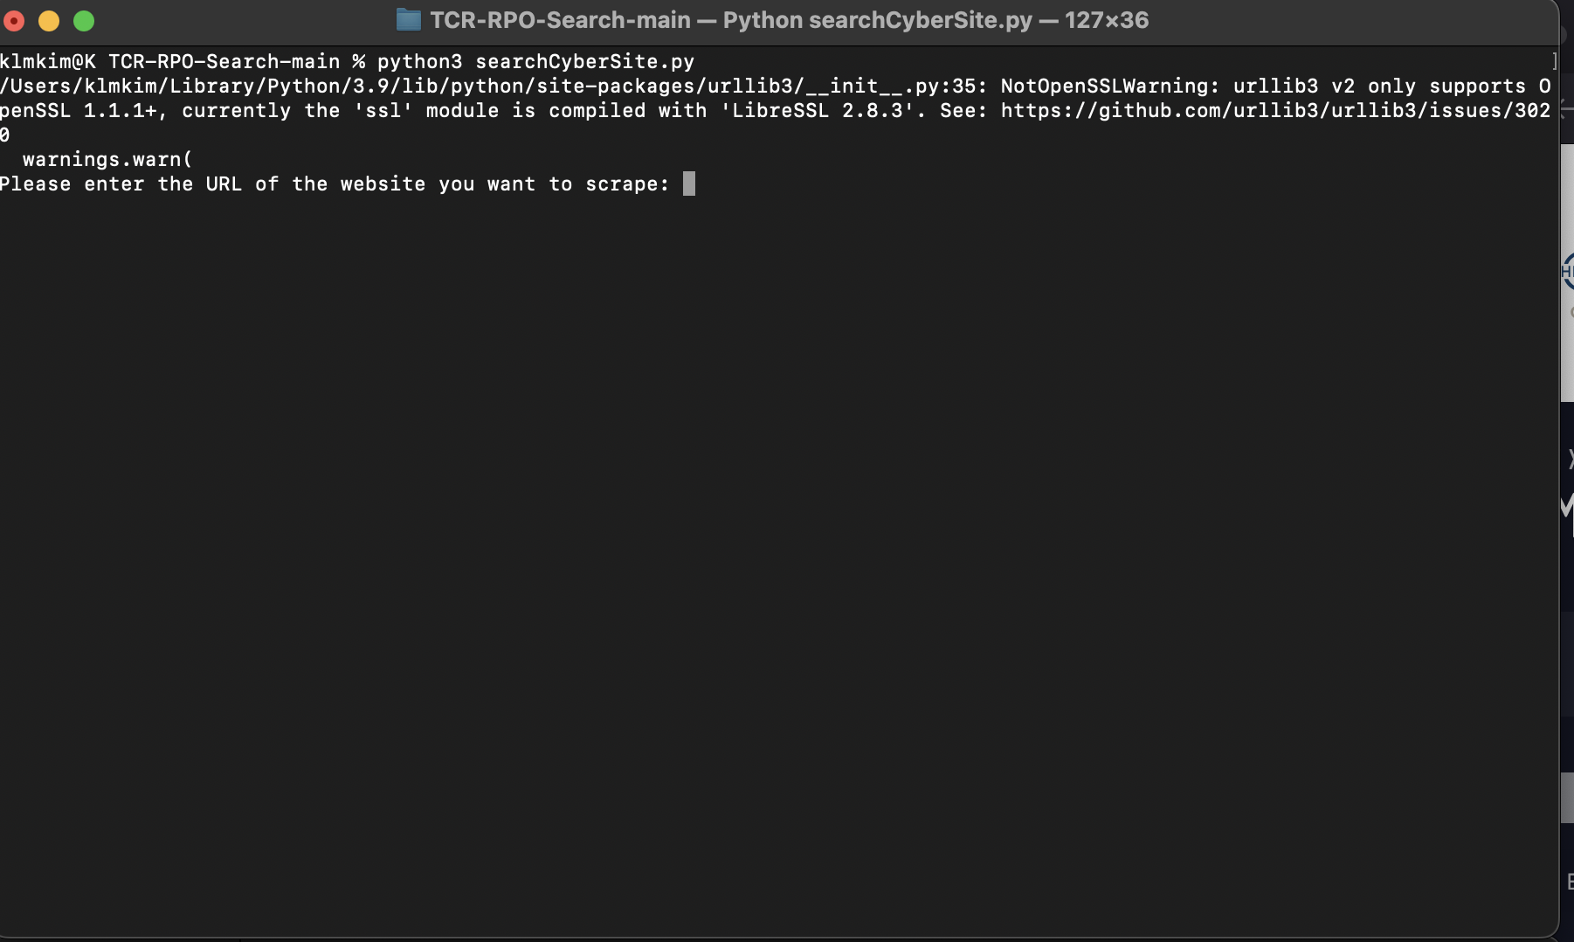
macos Set up
Open finder to the extracted GitHub folder.
Right click the folder and press “New Terminal at Folder”
Depending if you have pip or pip3 (check with command ‘pip --version’ or ‘pip3 --version’)
Run command ‘pip3 install pandas’
Run command ‘pip3 install selenium’
Run command ‘pip3 install beautifulsoup4’
Run command ‘pip3 install openpyxl’
Now you should be able to run command ‘python searchCyberSite.py’ or ‘python3 searchCyberSite.py’.

Slide 8
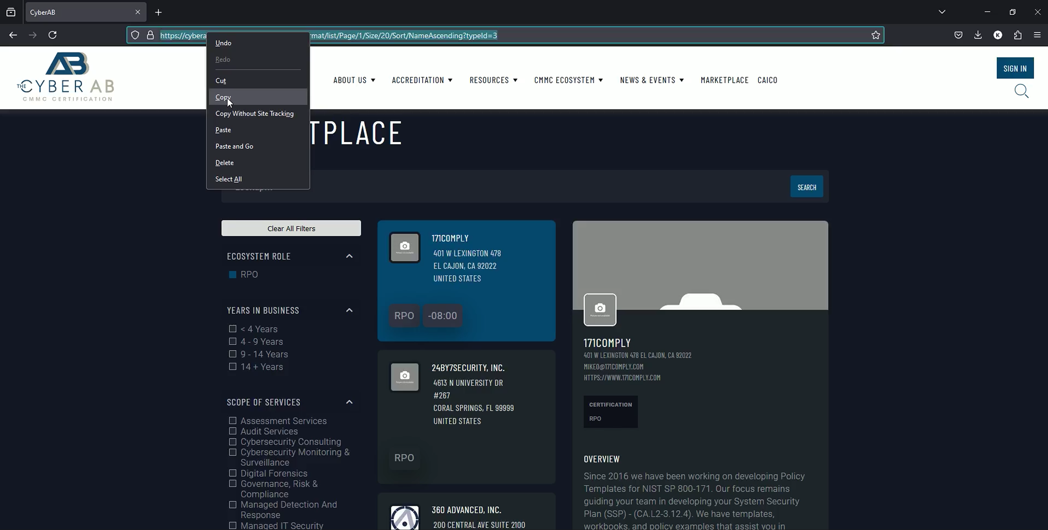
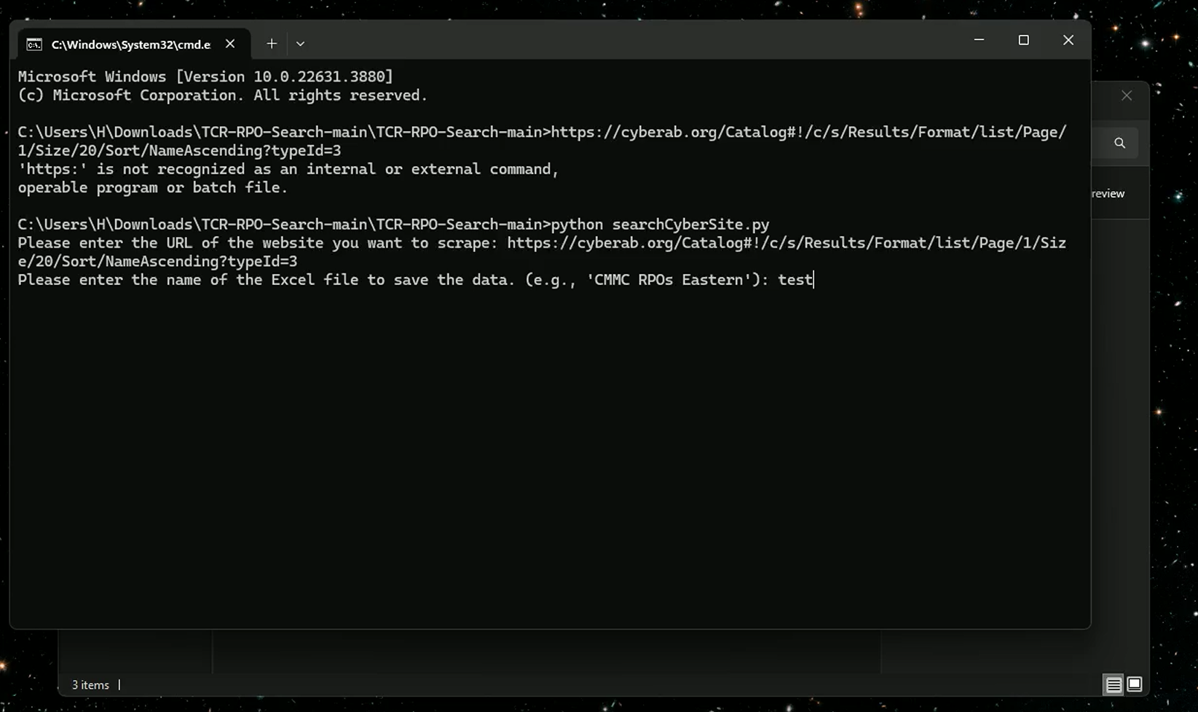
About the files
There is one python script to run: searchCyberSite.py
First, the script will prompt for a URL. The website to search is https://cyberab.org/ within the Marketplace tab.
Second, the script will prompt for a name to give the Excel file it will output. Make sure not to name it something that already exists, or it will be overwritten.
Once these are given, the script will begin searching, opening google chrome and going through the desired page.
Once complete, a new excel file will appear in the folder with all the results.

Slide 9
About the files
Check your searches
Make sure to copy the correct Url you would like to search.
Some searches will not work. For example, setting too many results on one page will cause memory to run out. To avoid this, try to narrow searches down and combine them later.
This may be fixed later.
Make sure you are naming you Excel files well, and not overwriting file names. Included are example Excel files, one of all CMMC RPOs and one of all RPOs in Connecticut and neighboring states.

Slide 10
THANK YOU
Klimentiy Kim
klimentiy.kim@netsafeid.com

